Slide 1
CEGE0004: Machine Learning for Data Science Lecture 4: Bayesian Learning Dr. Aldo Lipani

Slide 2
Bayesian Learning
A probabilistic approach to reasoning.
Based on the assumption that the quantities of interest are governed by probability distributions and that optimal decisions can be made by reasoning about them.
Bayesian learning provides:
Learning algorithms that directly manipulate probabilities;
Naïve Bayes classifier;
A useful perspective for understanding many learning algorithms:
In neural networks to justify loss functions;
In decision trees, why they favor short decision trees;
minimum description length principle.

Slide 3
Features of Bayesian Learning
Each observed training example can decrease or increase the estimated probability. This is more flexible than eliminating hypothesis if found inconsistent with some training examples.
Prior knowledge can be combined with observed data to determine the final probability of a hypothesis.
Can make probabilistic predictions.
New instances can be classified by combining multiple predictions of multiple hypotheses, weighted by their probabilities.

Slide 4
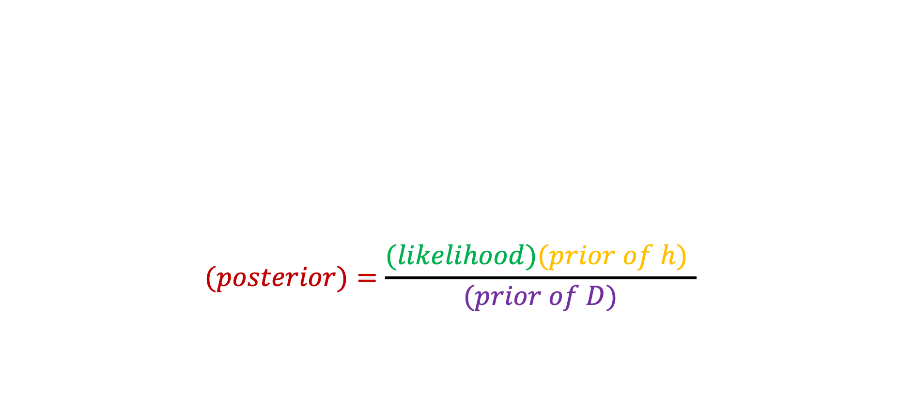
Bayes' Theorem
$$(posterior)=\frac{(likelihood)(prior of h) }{(prior of D)}$$

Slide 5
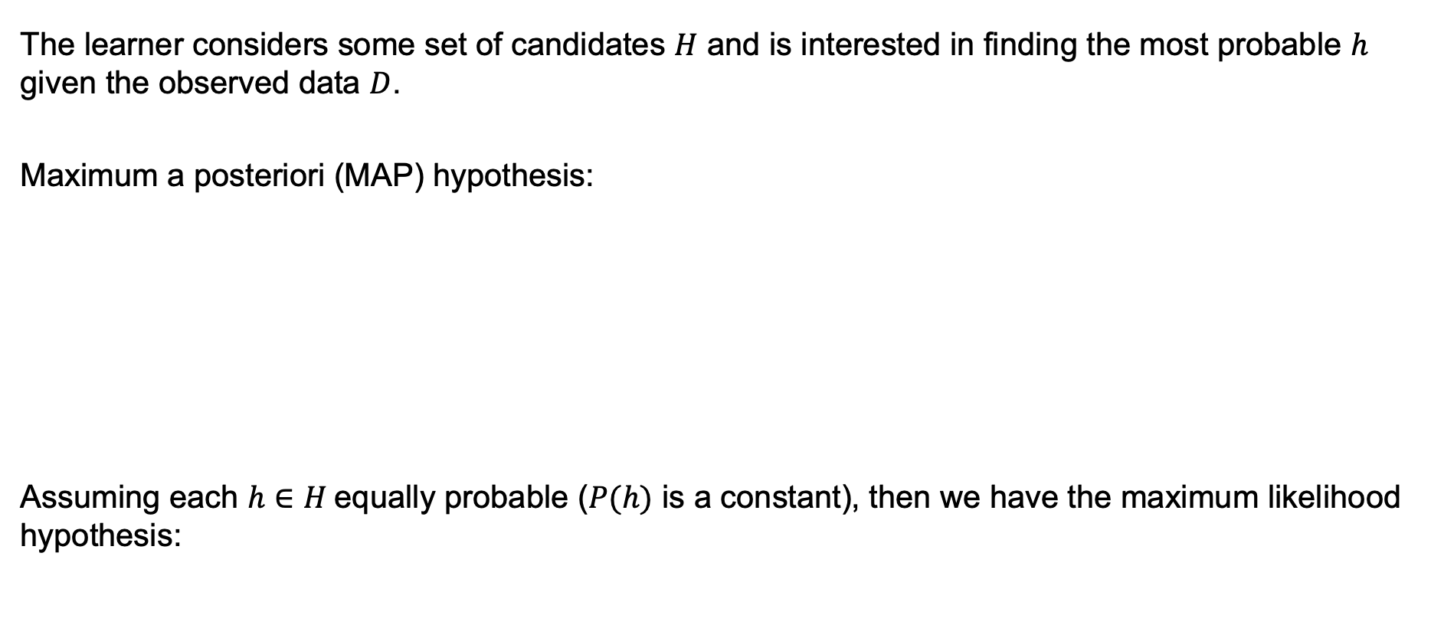
Choosing Hypotheses
The learner considers some set of candidates $H$ and is interested in finding the most probable $h$ given the observed data $D$.
Maximum a posteriori (MAP) hypothesis:
Assuming each $h∈H$equally probable ($P(h)$ is a constant), then we have the maximum likelihood hypothesis:

Slide 6

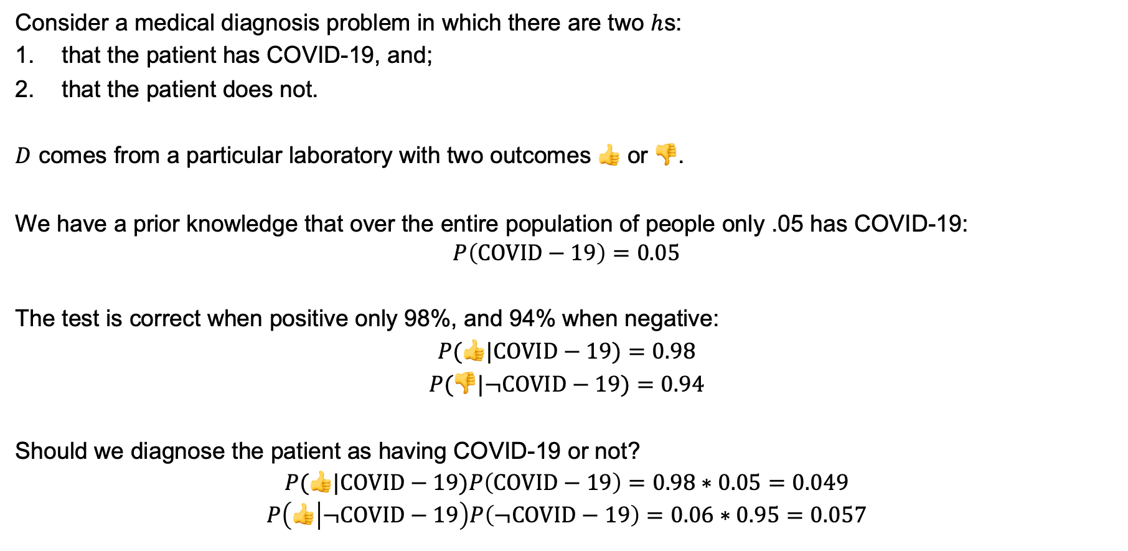
Example
Consider a medical diagnosis problem in which there are two $h$s:
that the patient has COVID-19, and;
that the patient does not.
$D$ comes from a particular laboratory with two outcomes 👍 or 👎.
We have a prior knowledge that over the entire population of people only .05 has COVID-19:
$$P\left(COVID−19\right)=0.05$$
The test is correct when positive only 98%, and 94% when negative:
$$P(👍|COVID−19)=0.98$$
$$P(👎|¬COVID−19)=0.94$$
Should we diagnose the patient as having COVID-19 or not?
$$P(👍|COVID−19)P\left(COVID−19\right)=0.98∗0.05=0.049$$
$$P\left(👍 | ¬COVID−19\right)P\left(¬COVID−19\right)=0.06∗0.95=0.057$$

Slide 7
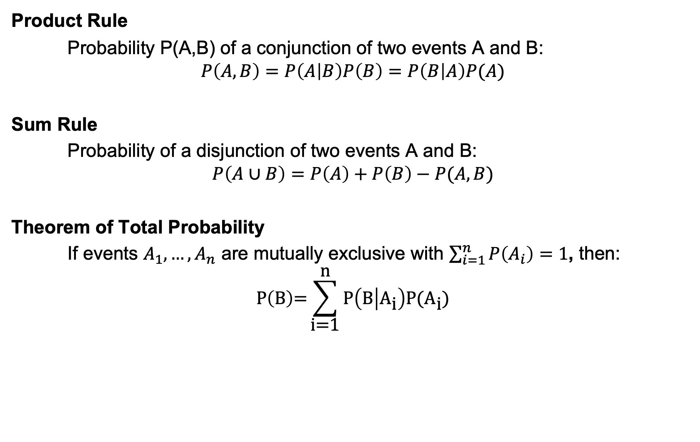
Basic Formulas for Probabilities
Product Rule
Probability P(A,B) of a conjunction of two events A and B:
$$P\left(A,B\right)=P\left(A | B\right)P\left(B\right)=P\left(B | A\right)P(A)$$
Sum Rule
Probability of a disjunction of two events A and B:
$$P\left(A∪B\right)=P\left(A\right)+P\left(B\right)−P(A,B)$$
Theorem of Total Probability
If events $A_{1}, …, A_{n}$ are mutually exclusive with $\sum_{i=1}^{n}{P\left(A_{i}\right)}=1$, then:
$$\text{P}\left(\text{B}\right)\text{=}\sum_{\text{i}\text{=1}}^{\text{n}}{\text{P}\left(\text{B} | {\text{A}}_{\text{i}}\right)\text{P}\text{(}{\text{A}}_{\text{i}}\text{)}}$$

Slide 8
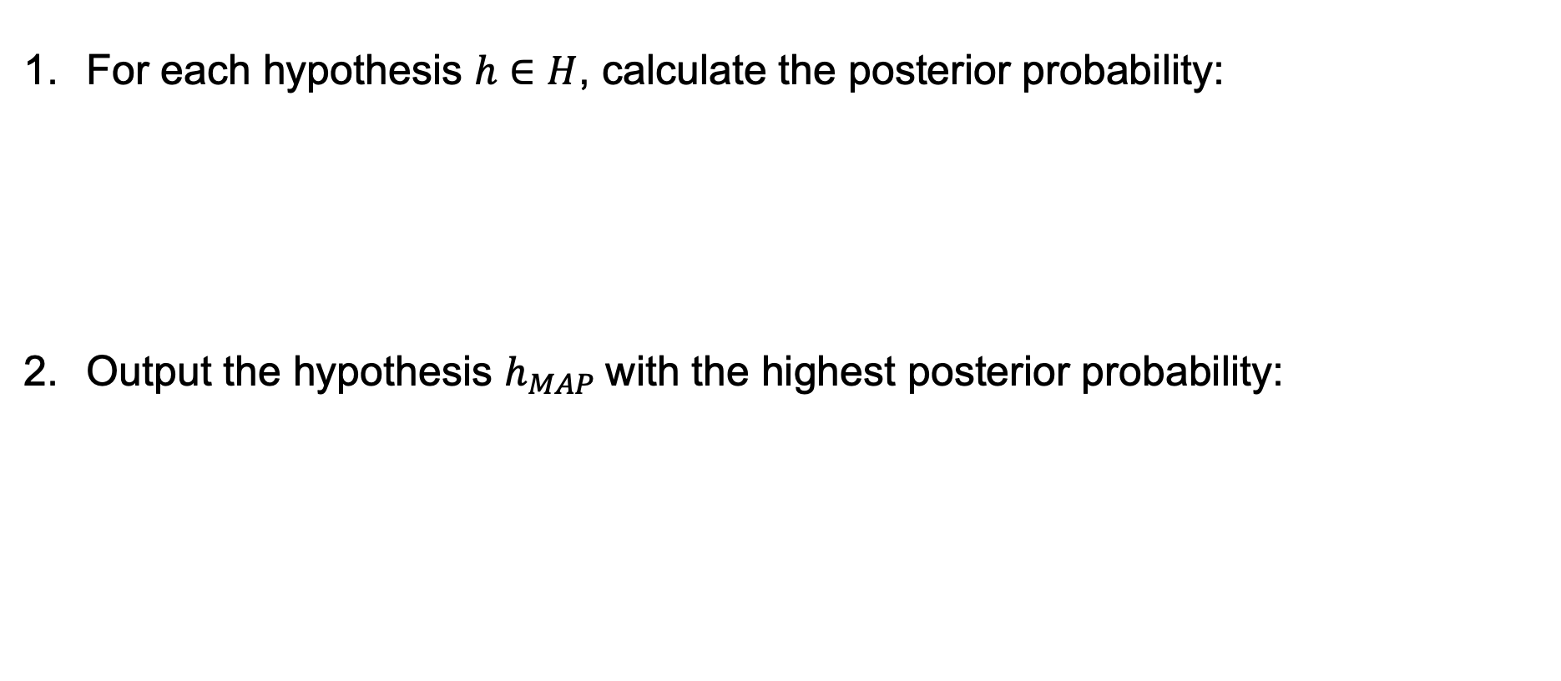
Brute-Force Bayes Concept Learning
tries all hypotheses
For each hypothesis $h∈H$, calculate the posterior probability:
Output the hypothesis $h_{MAP}$with the highest posterior probability:

Slide 9
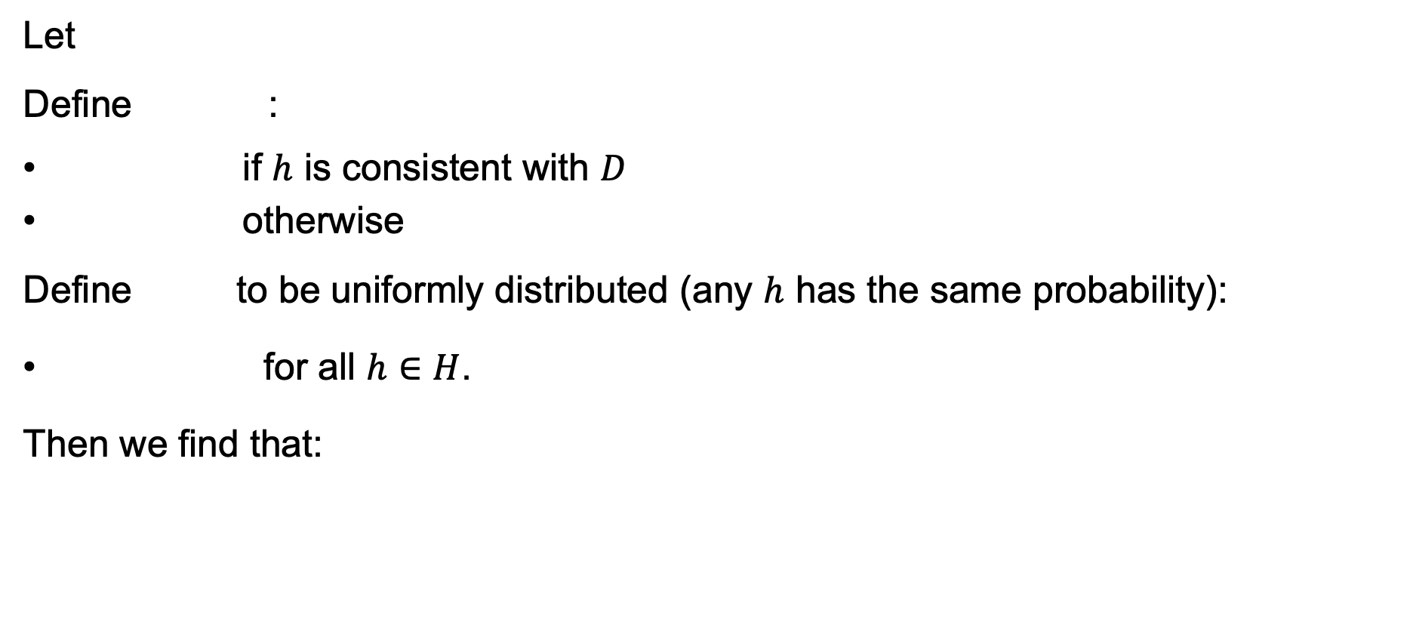
Brute-Force Bayes Concept Learning
tries all hypothesis
Let
Define :
if $h$ is consistent with $D$
otherwise
Define to be uniformly distributed (any $h$ has the same probability):
for all $h∈H$.
Then we find that:

Slide 10
Evolution of Posterior Probabilities
The posterior probability becomes more and more concentrated over the hypotheses contained in the version space.

Slide 11
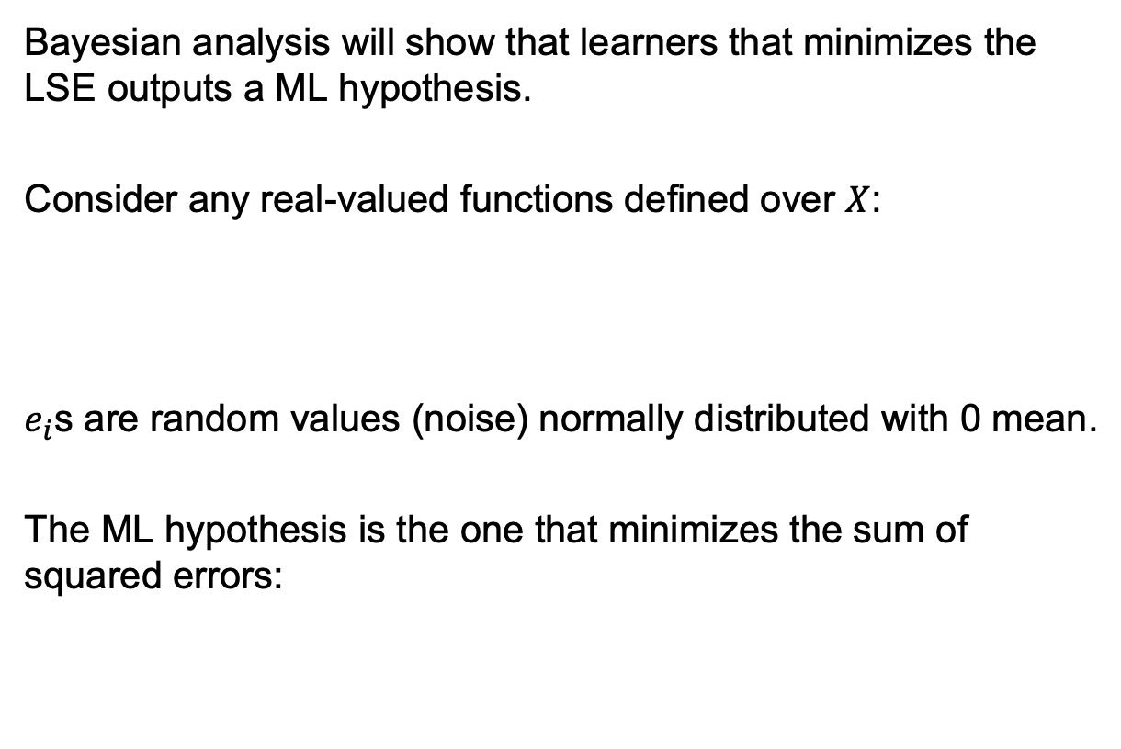
Learning a Real Valued Function
Bayesian analysis will show that learners that minimizes the LSE outputs a ML hypothesis.
Consider any real-valued functions defined over $X$:
$e_{i}$s are random values (noise) normally distributed with 0 mean.
The ML hypothesis is the one that minimizes the sum of squared errors:

Slide 12
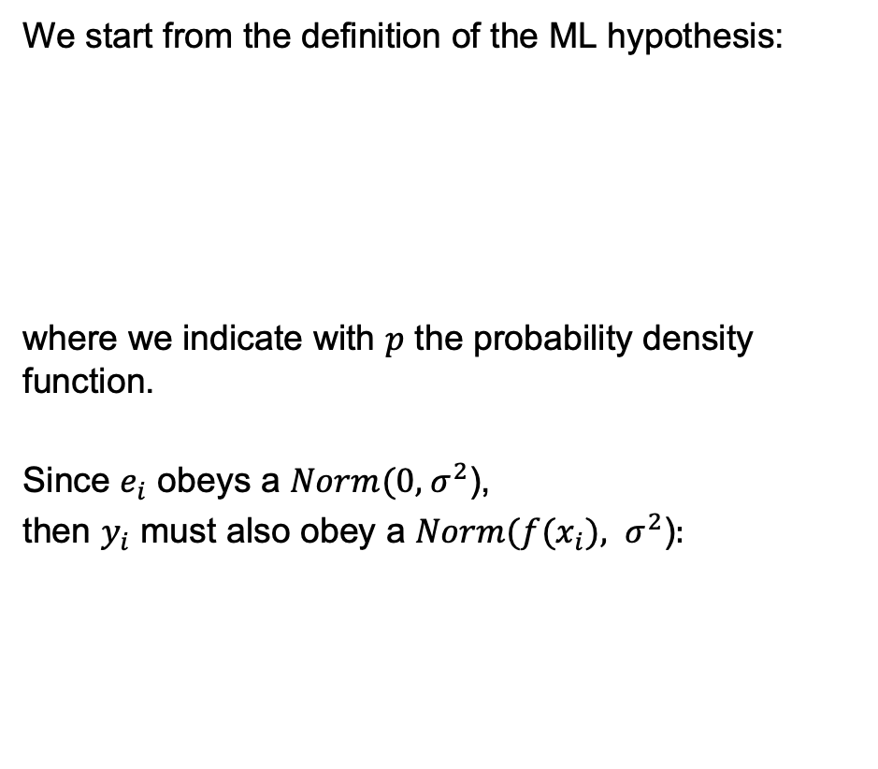
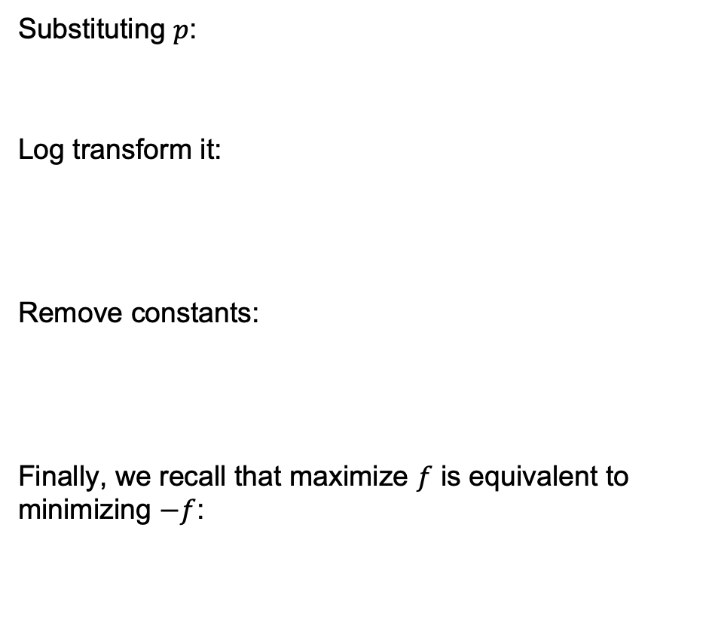
Let's Prove It…
We start from the definition of the ML hypothesis:
where we indicate with $p$ the probability density function.
Since $e_{i}$ obeys a $Norm(0,{ σ}^{2}$),
then $y_{i}$ must also obey a $Norm(f(x_{i}), σ^{2}$)$:$
Substituting $p$:
Log transform it:
Remove constants:
Finally, we recall that maximize $f$ is equivalent to minimizing $−f$:

Slide 13
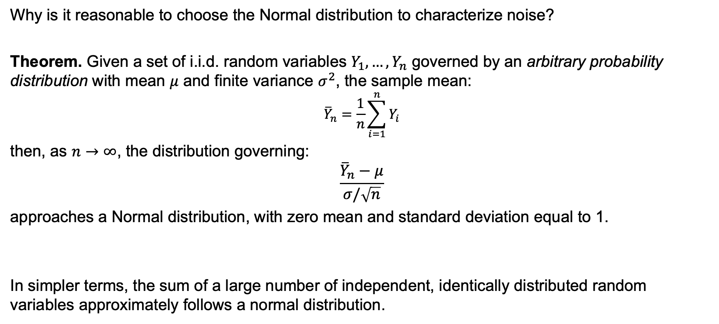
Central Limit Theorem
Why is it reasonable to choose the Normal distribution to characterize noise?
Theorem. Given a set of i.i.d. random variables $Y_{1}, …, Y_{n}$ governed by an arbitrary probability distribution with mean $μ$ and finite variance $σ^{2}$, the sample mean:
$${\overline{Y}}_{n}=\frac{1}{n}\sum_{i=1}^{n}{Y_{i}}$$
then, as $n→∞$, the distribution governing:
$$\frac{{\overline{Y}}_{n}−μ}{σ/\sqrt{n}}$$
approaches a Normal distribution, with zero mean and standard deviation equal to 1.
In simpler terms, the sum of a large number of independent, identically distributed random variables approximately follows a normal distribution.

Slide 14
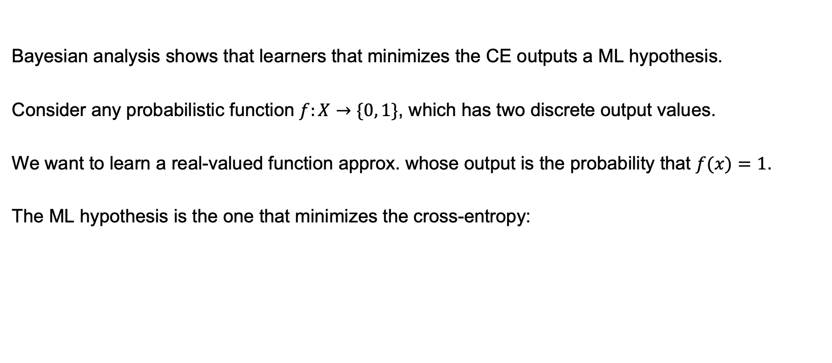
Learning a Probability Function
Bayesian analysis shows that learners that minimizes the CE outputs a ML hypothesis.
Consider any probabilistic function $f:X→\{0, 1\}$, which has two discrete output values.
We want to learn a real-valued function approx. whose output is the probability that $f(x)=1$.
The ML hypothesis is the one that minimizes the cross-entropy:

Slide 15
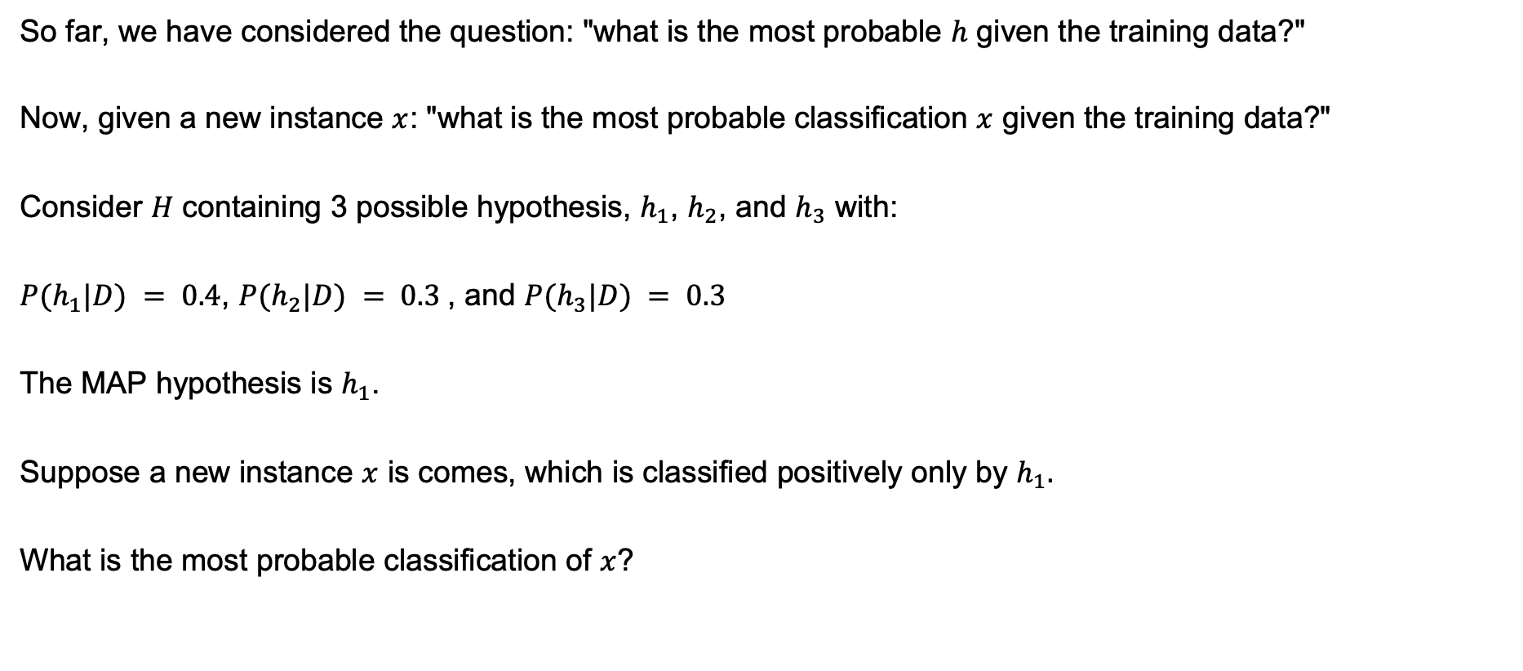
Bayes Optimal Classifier
So far, we have considered the question: "what is the most probable $h$ given the training data?"
Now, given a new instance $x$: "what is the most probable classification $x$ given the training data?"
Consider $H$ containing 3 possible hypothesis, $h_{1}$, $h_{2}$, and $h_{3}$ with:
$P(h_{1}|D) = 0.4$, $P(h_{2}|D) = 0.3$, and $P(h_{3}|D) = 0.3$
The MAP hypothesis is $h_{1}$.
Suppose a new instance $x$ is comes, which is classified positively only by $h_{1}.$
What is the most probable classification of $x$?

Slide 16
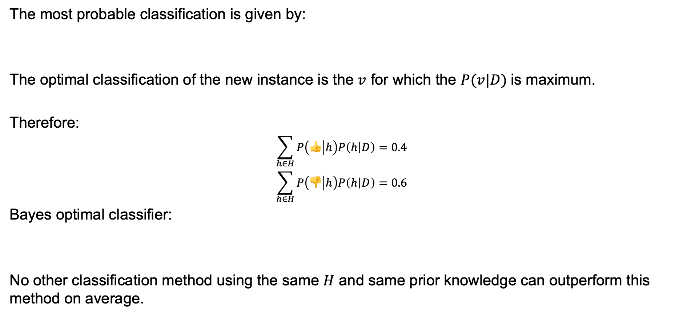
Bayes Optimal Classifier
The most probable classification is given by:
The optimal classification of the new instance is the $v$ for which the $P(v|D)$is maximum.
Therefore:
$$\sum_{h∈H}{P\left(👍 | h\right)P\left(h | D\right)=0.4}$$
$$\sum_{h∈H}{P\left(👎 | h\right)P\left(h | D\right)=0.6}$$
Bayes optimal classifier:
No other classification method using the same $H$ and same prior knowledge can outperform this method on average.

Slide 17
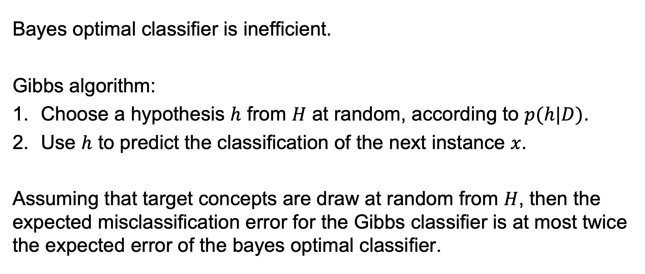
Gibbs Classifier
Bayes optimal classifier is inefficient.
Gibbs algorithm:
Choose a hypothesis $h$ from $H$ at random, according to $p(h|D)$.
Use $h$ to predict the classification of the next instance $x$.
Assuming that target concepts are draw at random from $H$, then the expected misclassification error for the Gibbs classifier is at most twice the expected error of the bayes optimal classifier.

Slide 18
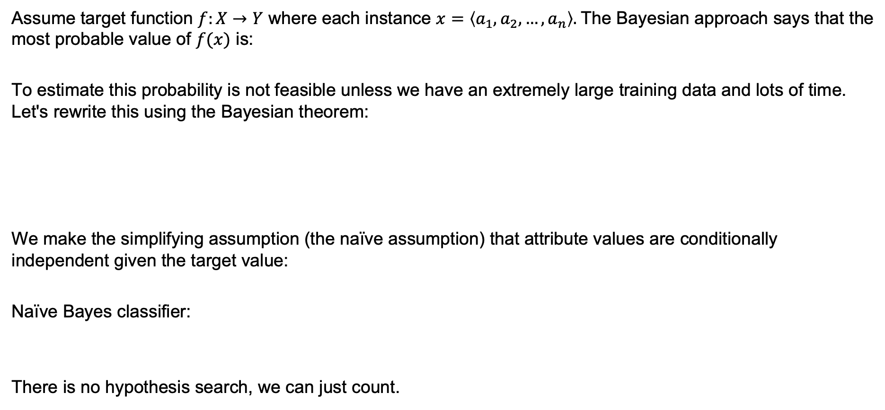
Naïve Bayes Classifier
Assume target function $f:X→Y$ where each instance $x=\left\langle a_{1}, a_{2}, …, a_{n}\right\rangle .$The Bayesian approach says that the most probable value of $f(x)$ is:
To estimate this probability is not feasible unless we have an extremely large training data and lots of time. Let's rewrite this using the Bayesian theorem:
We make the simplifying assumption (the naïve assumption) that attribute values are conditionally independent given the target value:
Naïve Bayes classifier:
There is no hypothesis search, we can just count.

Slide 19
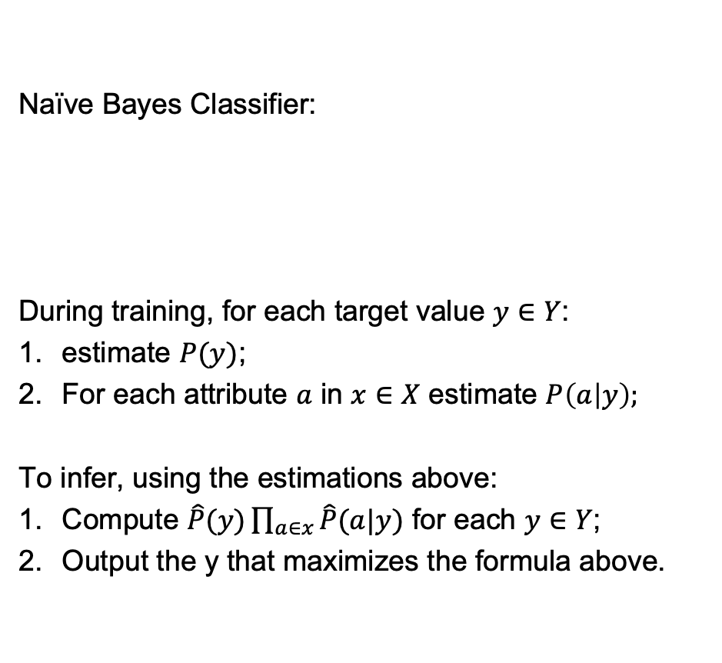
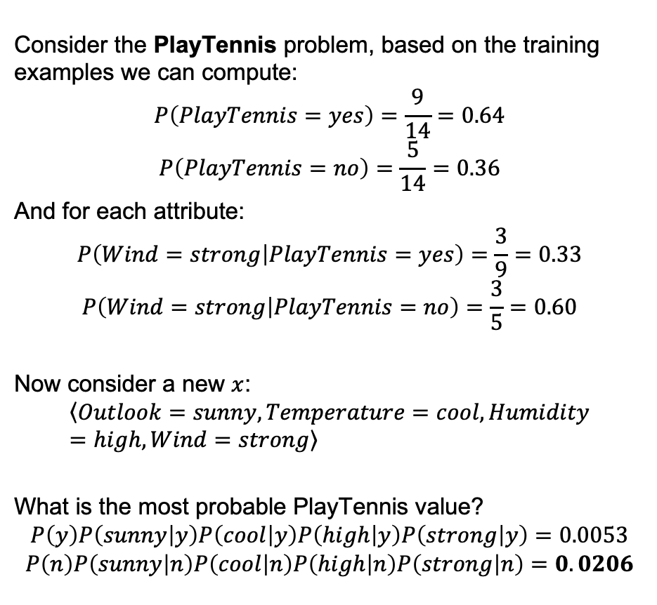
Naïve Bayes Algorithm
Naïve Bayes Classifier:
During training, for each target value $y∈Y$:
estimate $P(y)$;
For each attribute $a$ in $x∈X$ estimate $P\left(a | y\right);$
To infer, using the estimations above:
Compute $\hat{P}(y)\prod_{a∈x}{\hat{P}(a|y)}$ for each $y∈Y$;
Output the y that maximizes the formula above.
Consider the PlayTennis problem, based on the training examples we can compute:
$$P\left(PlayTennis=yes\right)=\frac{9}{14}=0.64$$
$$P\left(PlayTennis=no\right)=\frac{5}{14}=0.36$$
And for each attribute:
$$P\left(Wind=strong | PlayTennis=yes\right)=\frac{3}{9}=0.33$$
$$P\left(Wind=strong | PlayTennis=no\right)=\frac{3}{5}=0.60$$
Now consider a new $x$:
$$\left\langle Outlook=sunny, Temperature=cool, Humidity=high, Wind=strong\right\rangle$$
What is the most probable PlayTennis value?
$$P\left(y\right)P\left(sunny | y\right)P\left(cool | y\right)P\left(high | y\right)P\left(strong | y\right)=0.0053$$
$$P\left(n\right)P\left(sunny | n\right)P\left(cool | n\right)P\left(high | n\right)P\left(strong | n\right)=0.0206$$

Slide 20
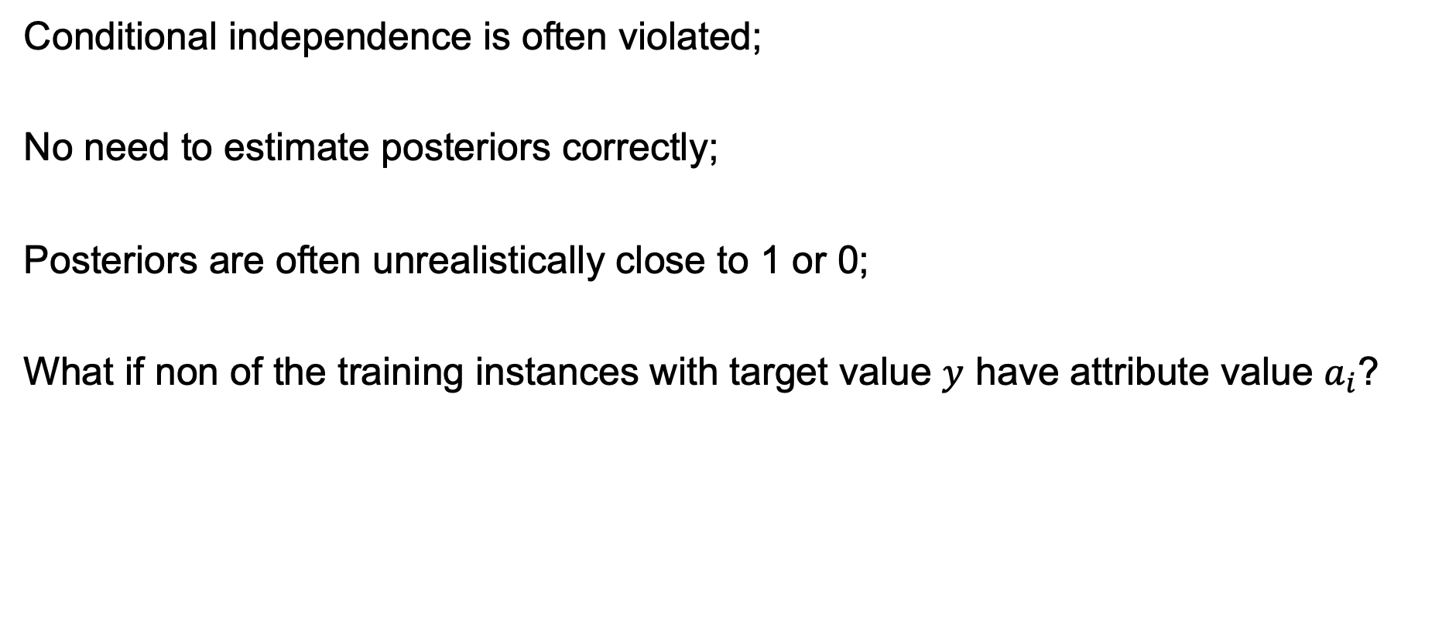
Issues with Naïve Bayes
Conditional independence is often violated;
No need to estimate posteriors correctly;
Posteriors are often unrealistically close to 1 or 0;
What if non of the training instances with target value $y$ have attribute value $a_{i}$?

Slide 21
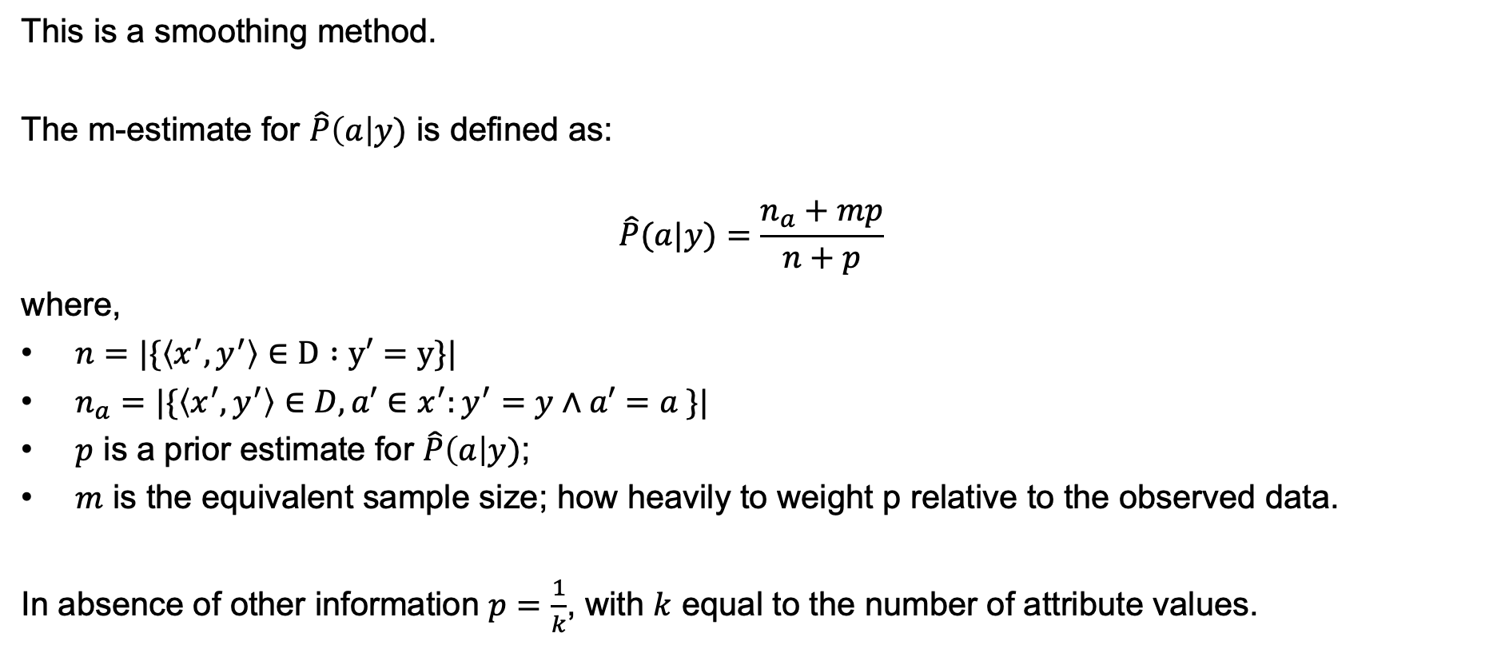
m-estimate of probability
This is a smoothing method.
The m-estimate for $\hat{P}\left(a\right|y)$ is defined as:
$$\hat{P}(a|y)=\frac{n_{a}+mp}{n+p}$$
where,
$n=|\{\left\langle x^{′},y^{′}\right\rangle ∈D :y′=y\}|$
$n_{a}=|\{\left\langle x^{′},y^{′}\right\rangle ∈D, a′∈x^{′}:y^{′}=y∧a′=a \}|$
$p$ is a prior estimate for $\hat{P}\left(a\right|y)$;
$m$ is the equivalent sample size; how heavily to weight p relative to the observed data.
In absence of other information $p=\frac{1}{k}$, with $k$ equal to the number of attribute values.

Slide 22
Learning to Classify Text
Naïve Bayes is one of the most effective algorithms to classify text.
Applications:
Learn which news articles are of your interest;
Learn to classify web pages by topic;
Learn to filter your emails;
Etc.
What attributes shall we use to represent text documents?
one attribute per word position;
bag-of-words, break the positions and focus only on the words.

Slide 23
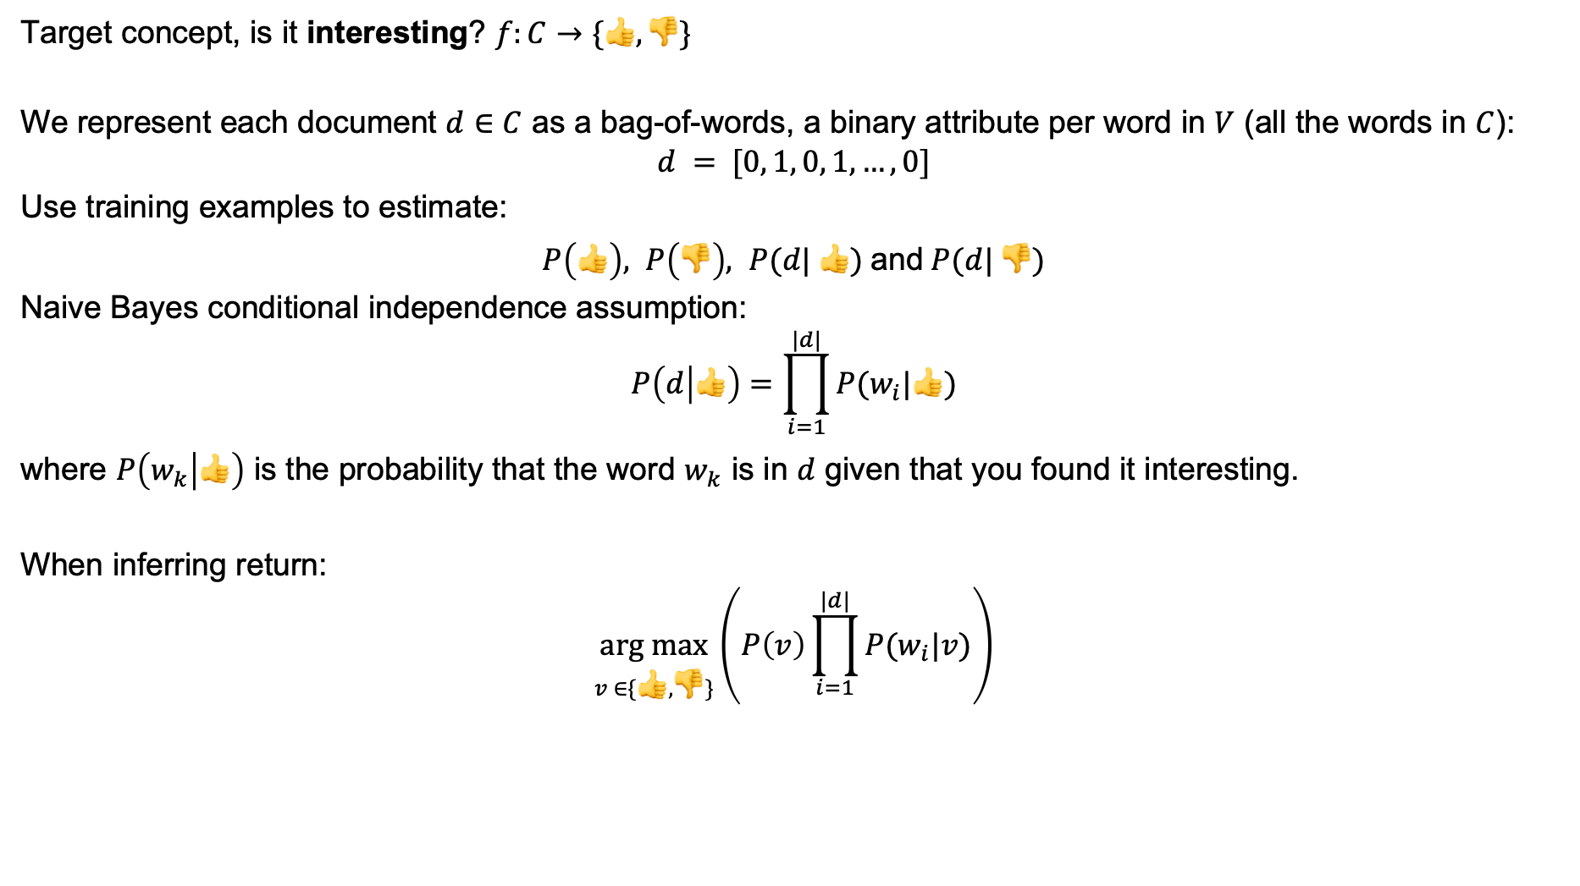
Learning to Classify Text
Target concept, is it interesting? $f:C→\{👍, 👎\}$
We represent each document $d∈C$ as a bag-of-words, a binary attribute per word in $V$ (all the words in $C$):
$$d = [0, 1, 0, 1, …, 0]$$
Use training examples to estimate:
$P\left(👍\right), P\left(👎\right), P(d| 👍)$and$P(d| 👎)$
Naive Bayes conditional independence assumption:
$$P\left(d | 👍\right)=\prod_{i=1}^{|d|}{P(w_{i}|👍)}$$
where $P\left(w_{k} | 👍\right)$ is the probability that the word $w_{k}$ is in $d$ given that you found it interesting.
When inferring return:
$$\underset{v ∈\{👍, 👎\}}{arg max}\left(P\left(v\right)\prod_{i=1}^{|d|}{P(w_{i}|v)}\right)$$

Slide 24
Bayesian Belief Networks
Naïve Bayes assumption of conditional independence is too restrictive;
If we do not make the Naïve Bayes assumption the problem becomes intractable;
Bayesian networks describe conditional independence among subsets of variables;
This allows combining prior knowledge about (in)dependencies among variables with observed data.

Slide 25
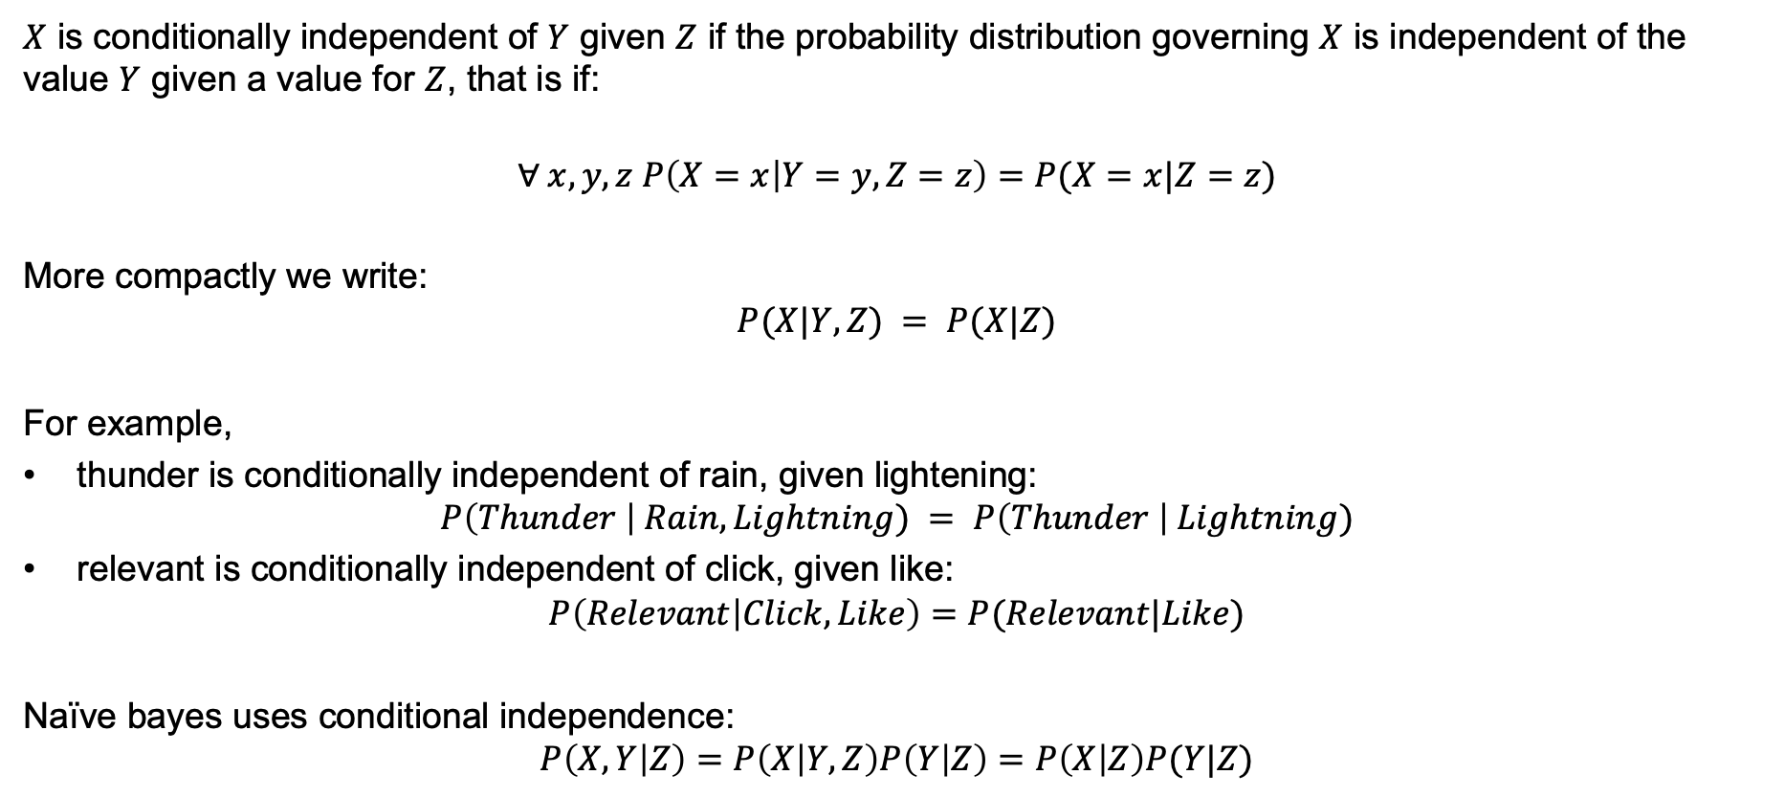
Conditional Independence
$X$ is conditionally independent of $Y$ given $Z$ if the probability distribution governing $X$ is independent of the value $Y$ given a value for $Z$, that is if:
$$∀ x, y,z P\left(X=x | Y=y,Z=z\right)=P(X=x|Z=z)$$
More compactly we write:
$$P(X|Y,Z) = P(X|Z)$$
For example,
thunder is conditionally independent of rain, given lightening:
$$P\left(Thunder \right| Rain, Lightning) = P\left(Thunder \right| Lightning)$$
relevant is conditionally independent of click, given like:
$$P\left(Relevant | Click,Like\right)=P(Relevant|Like)$$
Naïve bayes uses conditional independence:
$$P\left(X,Y | Z\right)=P\left(X | Y,Z\right)P\left(Y | Z\right)=P\left(X | Z\right)P(Y|Z)$$

Slide 26
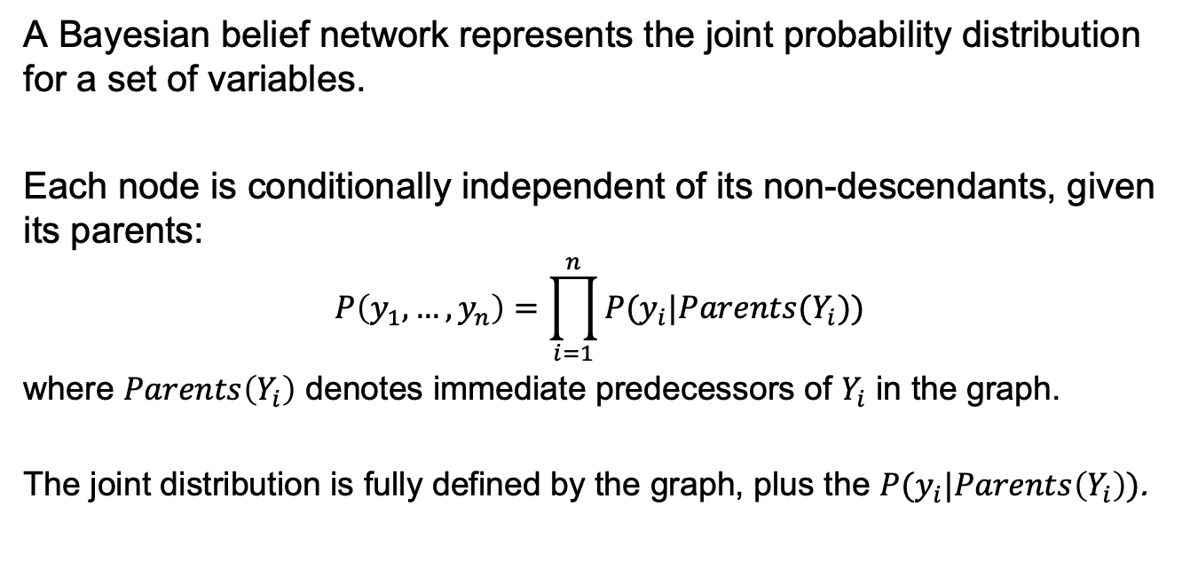
Representation
A Bayesian belief network represents the joint probability distribution for a set of variables.
Each node is conditionally independent of its non-descendants, given its parents:
$$P\left(y_{1},…,y_{n}\right)=\prod_{i=1}^{n}{P(y_{i}|Parents(Y_{i})})$$
where $Parents\left(Y_{i}\right)$ denotes immediate predecessors of $Y_{i}$ in the graph.
The joint distribution is fully defined by the graph, plus the $P(y_{i}|Parents\left(Y_{i}\right))$.
$$P\left(ForestFire, Thunder, Lightning, Campfire,Storm,BusTourGroup\right)=$$
$$P\left(ForestFire | Campfire, Lightning, Storm\right)P\left(Thunder | Lightning\right)P\left(Campfire | Storm, BusTourGroup\right)$$
$$P(Lightning|Storm)P(Storm)P(BusTourGroup)$$

Slide 27
Inference in Bayesian Belief Networks
We might wish to use a Bayesian network to infer the value of some target variable given the observed values of the other variables.
Bayes networks contain all the information needed to do this, if values for the other variables are known. However, in general, exact inference is known to be NP-hard.
In practice, can succeed in many cases:
Exact inference methods work well for some network structures;
Monte Carlo methods "simulate" the network randomly to calculate the approximate solutions.

Slide 28
Learning Bayesian Networks
Can we devise effective algorithms for learning Bayesian belief networks from training data?
Several variants can be considered:
Network structure may be known or unknown;
Training examples might provide values of all network variables, or just some.
If structure is known and no missing values, this task is as easy as learning a Naïve Bayes classifier.

Slide 29
The Expectation-Maximization (EM) Algorithm
Suppose that the structure is known, and variables are partially observed.
For example, we observe:
ForestFire, Storm, BusTourGroup, and Thunder.
But we don't observe:
Lightning and Campfire.
Initialize parameters ignoring missing information.
Repeat until convergence:
E step:
Calculate expected values of unobserved variables, assuming current parameter values.
M step:
Calculate new parameter values to maximize probability of data (observed & estimated).

Slide 30
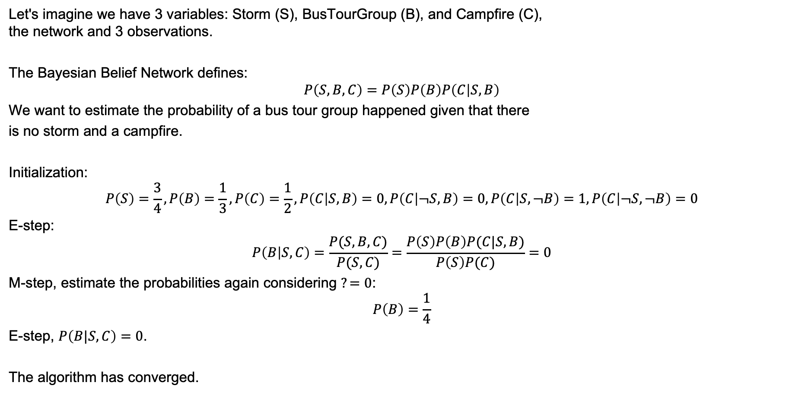
Example
S
B
C
Let's imagine we have 3 variables: Storm (S), BusTourGroup (B), and Campfire (C), the network and 3 observations.
The Bayesian Belief Network defines:
$$P\left(S,B,C\right)=P\left(S\right)P\left(B\right)P\left(C | S,B\right)$$
We want to estimate the probability of a bus tour group happened given that there
is no storm and a campfire.
Initialization:
$$P\left(S\right)=\frac{3}{4}, P\left(B\right)=\frac{1}{3},P\left(C\right)=\frac{1}{2},P\left(C | S,B\right)=0, P\left(C | ¬S,B\right)=0,P\left(C | S,¬B\right)=1,P\left(C | ¬S,¬B\right)=0$$
E-step:
$$P\left(B | S,C\right)=\frac{P(S,B,C)}{P(S, C)}=\frac{P\left(S\right)P\left(B\right)P(C|S,B)}{P\left(S\right)P(C)}=0$$
M-step, estimate the probabilities again considering $?=0$:
$$P\left(B\right)=\frac{1}{4}$$
E-step, $P\left(B|S,C\right)=0$.
The algorithm has converged.
S | B | C
0 | 0 | 0
1 | 1 | 0
1 | 0 | 1
1 | ? | 1

Slide 31
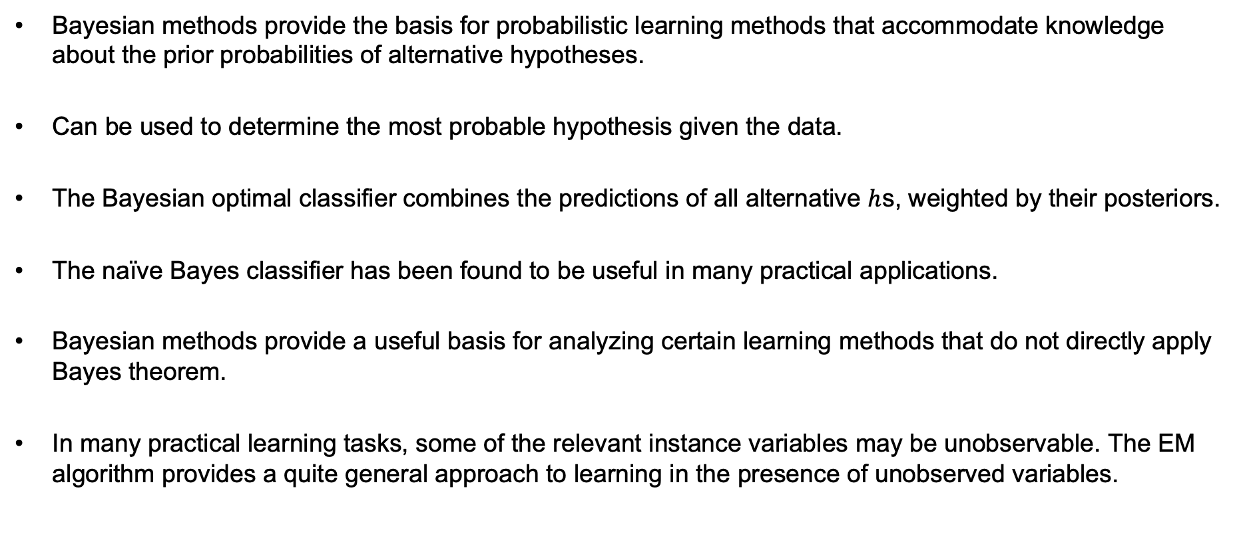
Summary
Bayesian methods provide the basis for probabilistic learning methods that accommodate knowledge about the prior probabilities of alternative hypotheses.
Can be used to determine the most probable hypothesis given the data.
The Bayesian optimal classifier combines the predictions of all alternative $h$s, weighted by their posteriors.
The naïve Bayes classifier has been found to be useful in many practical applications.
Bayesian methods provide a useful basis for analyzing certain learning methods that do not directly apply Bayes theorem.
In many practical learning tasks, some of the relevant instance variables may be unobservable. The EM algorithm provides a quite general approach to learning in the presence of unobserved variables.

